Slide 1

DEPARTMENT OF PHILOSOPHY

Slide 2
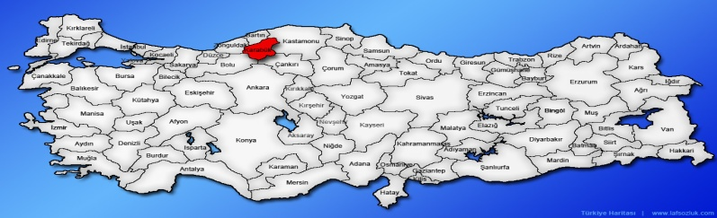
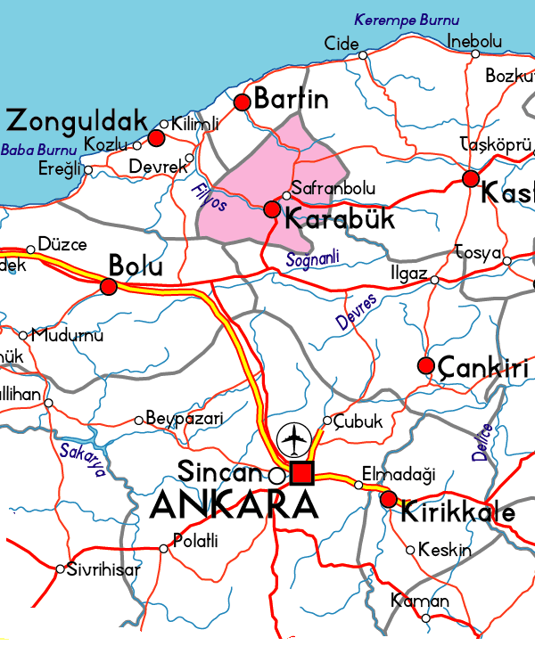
LoCATION

Slide 3
DEPARTMENT OF PHILOSOPHY
“We must always be humans who seek the truth and dare to express it as we find it and are convinced that we have found it.”
M. Kemal ATATURK

Slide 4
DEPARTMENT OF PHILOSOPHY
Philosophy is a research goal aimed at understanding humans, the universe and nature. Philosophy is the search for truth and reality. While searching for these, it seeks answers to questions such as "What am I? What is the universe? Where do I come from? Where are we going? What is the meaning of life? What should we believe?"

Slide 5
DEPARTMENT OF PHILOSOPHY
Our department was established in 2011. The department started accepting students in 2013-2014. Students who enroll the Philosophy Department of the Faculty of Letters will study in our department for 8 semesters.

Slide 6
DEPARTMENT OF PHILOSOPHY
The main purpose is to enable students to experience what science, scientific method and scientific knowledge are, to gain philosophical or scientific doubt, curiosity, excitement of research and discovery, to develop inquisitive thinking skills, to acquire a strong theoretical background regarding philosophical activity, and to apply this philosophical knowledge to daily life. Our goal will be to create a scientific, academic and social environment where they will understand how to adapt themselves and activate and sustain their academic and individual development.

Slide 7
DEPARTMENT OF PHILOSOPHY
In the light of universal values, by benefiting from the knowledge of science in general and the history of philosophy in particular, it aims to raise highly qualified philosophers who can stand on their own feet, which the country and humanity need, and to offer its production in the fields of education and research for the benefit of society and humanity.

Slide 8
DEPARTMENT OF PHILOSOPHY
In our department, there are 4 divisions:
1-History of Philosophy
2-Systematic Philosophy and Logic
3-History of Turkish Islamic Thought
4-History of Science

Slide 9
DEPARTMENT OF PHILOSOPHY
While general topics of philosophy are taught in the first two years of the curriculum, emphasis will be placed on philosophical problems starting from the third year. The curriculum also includes sociology and psychology courses.

Slide 10
DEPARTMENT OF PHILOSOPHY
Graduates who received the title of "Philosophy Scholar" from the department, in addition to pursuing an academic career, can also work in private and Ministry of Education schools, advertising agencies, and various public and private organizations that recruit personnel from the philosophy department. They have also the opportunity to work in human resources departments.

